Slide 1
PHILIPS IDEATHON 2025
TITLE PAGE
Use Case – 1
Problem Statement Title - AI Powered FAQ Chatbot

Slide 2
AI Powered FAQ Chatbot
Our Solution presents a Chatbot, designed to assist users with their queries about static data as well as dynamic data and also acts as a feedback platform for the user to refine his/her queries subject to requirements, thereby offering an all-in-one solution.
The Chatbot is integrated with the Google Translation API, providing multilingual support, and is also connected to an LLM-based RAG pipeline, which utilizes a curated set of museum information documents in order to reply to the tourists.
We have a Crowd Management System with which the help of the Museums population database that returns an optimal itinerary of the museums the tourist has to visit and also returns the a list of overcrowding museums.
Our Crowd Management System generates an optimal itinerary that not only prevents overcrowding at popular museums but also includes lesser-known museums, thereby boosting revenue for the government.
Now we send this optimal itinerary to the tourist who can edit it(in a multilingual webpage) if needed to suit his needs(but cant choose the list of overcrowded museums) and he/she is directed to a payment gateway for the completion of the payment and the ticket is sent as QR code back to the WhatsApp chatbot.
Innovation and uniqueness of the solution:
Our solution presents a WhatsApp chatbot making it the most accessible way for tourists to book their tickets and we can integrate our solution into tourism transport services and hotel booking services.
Our solution generalizes to all kinds of tourist destinations like temples, national parks, zoos etc.

Slide 3


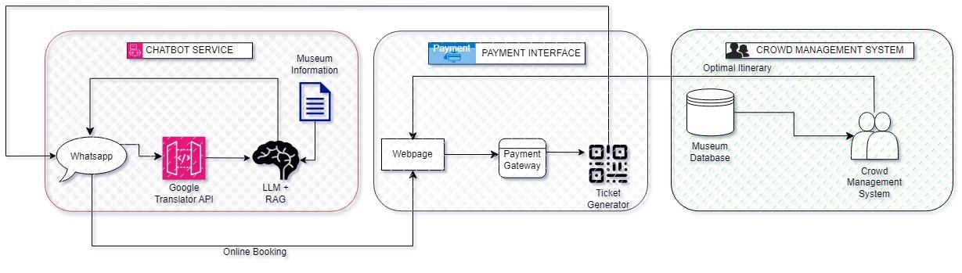
TECHNICAL APPROACH

Slide 4

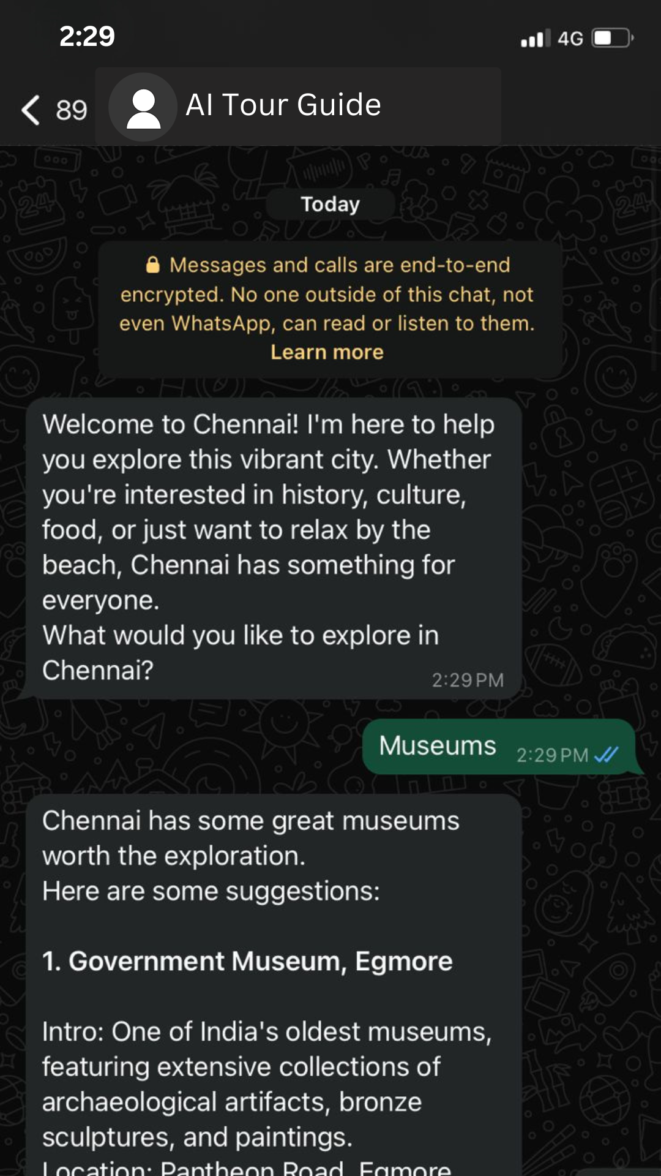
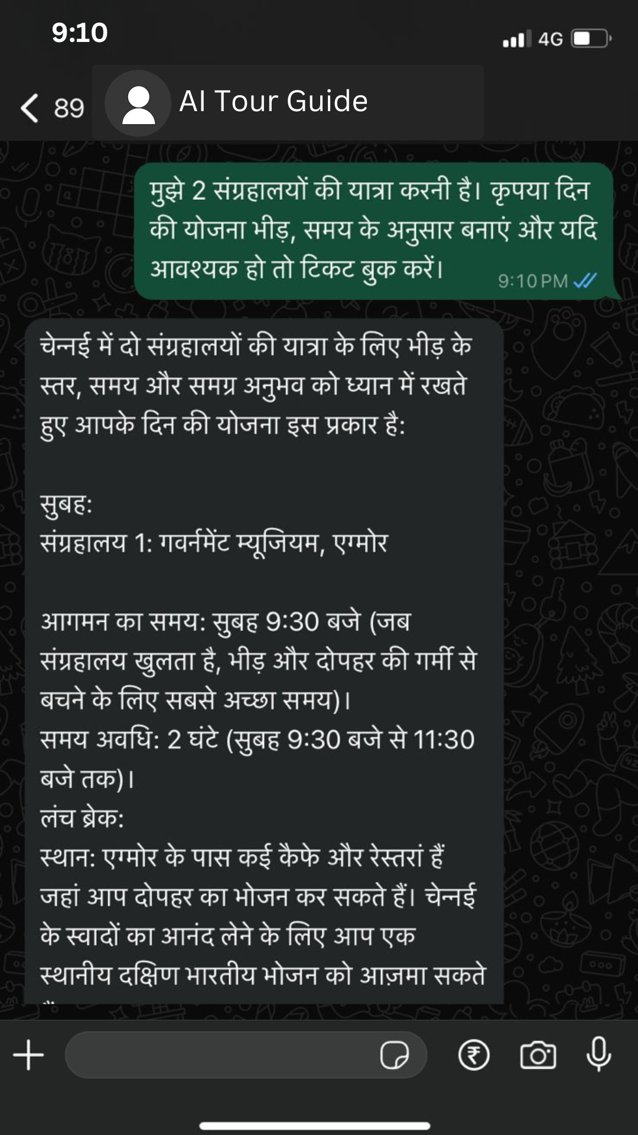
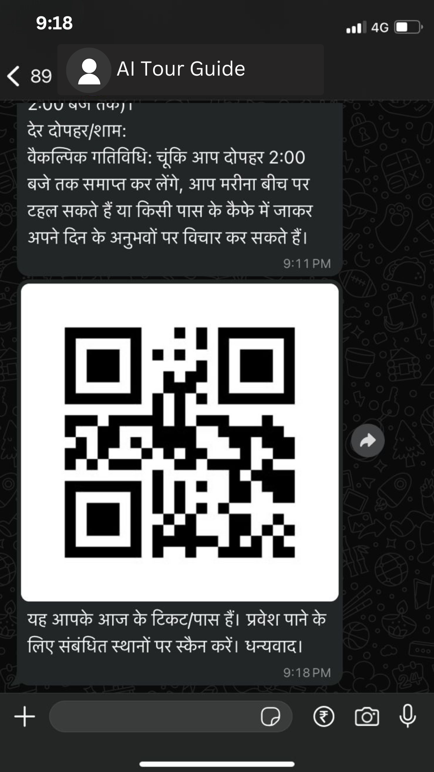
FEASIBILITY AND VIABILITY
Analysis of the feasibility of the idea:
Our solution involves technologies(GenAI, Automation) which are being implemented successfully in the past few years.
Financially speaking LLMs like ChatGPT, llama are not feasible but we will be using fine tuned version of smaller models like dynamic_tinybert,t5-small which specialize in document based question answering thereby causing an exponential decrease in cost per llm call.
Potential challenges:
Our GenAi architecture and Crowd management system can sometimes be contrary to each other i.e the GenAi architecture influences the optimal itinerary to better suit the tourist’s needs and might cause discrepancies to crowd management.
The data collected from different museums might be of various types and has to be be accessible by our rag pipeline for document based question answering.
Strategies for overcoming these challenges:
Negative prompt engineering and other prompting techniques will help overcome this problem and limits GenAI architecture’s ability to mess with our Crowd Management System.
LlamaIndex overcomes this challenge by providing libraries to convert pptx, docx, images, tables etc.. to a format accessible by our rag pipeline.

Slide 5
IMPACT AND BENEFITS
Potential Impact on the Target Audience:
Multilingual support on Whatsapp: Easy booking on Whatsapp, which is the most widely used messaging app(with over 535.8 million active users in India as of May 2024) , with multilingual support improves accessibility and reduces wait times, enhancing convenience.
Increased Attendance: Simplified booking and targeted promotions encourage more visits, driving up attendance.
Direct Access of Information: Allows easier customer experience by eliminating third party between the tourist and the government so that the tourist can get all the information on whatsapp itself without having to refer to an external search engine.
Benefits of the Solution:
Social: Promotes cultural engagement and inclusivity by making museums more accessible to diverse audiences.
Economic: Boosts revenue through increased attendance, cost savings from automation, and data-driven marketing insights.
Capable of handling heavy traffic: Crowd management system allows heavy load to be handled smoothly.
Reliable data collection: Our project utilises government-provided data to ensure accurate and reliable information, enhancing the visitor experience with up-to-date details on museum offerings.
Marketing and promotion: Our crowd management system's optimal itinerary promotes lesser-known and underrated museums with boosts revenue.
Others: Cost effective solution, exploratory data analysis on our database.

Slide 6
RESEARCH AND REFERENCES
LAMA INDEX : https://docs.llamaindex.ai/en/stable/understanding/querying/querying/
GOOGLE TRANSLATE API : https://cloud.google.com/translate/docs/reference/rest
LANGCHAIN: https://www.researchgate.net/publication/372529063_An_Effective_Query_System_Using_LLMs_and_LangChain
PROMPT ENGINEERING :https://link.springer.com/article/10.1007/s10439-023-03272-4
RAG : https://docs.llamaindex.ai/en/stable/understanding/querying/querying/
QUEUES : https://www.academia.edu/download/83311728/4-Automated-Queue-Management.pdf

